Slide 1
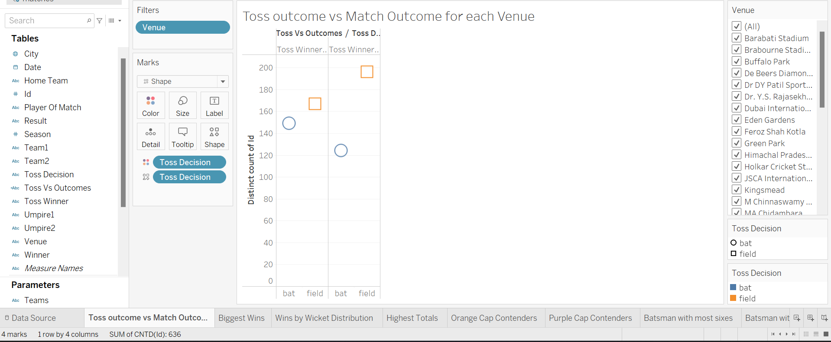
Most of the times the teams who won the toss won the match

Slide 2
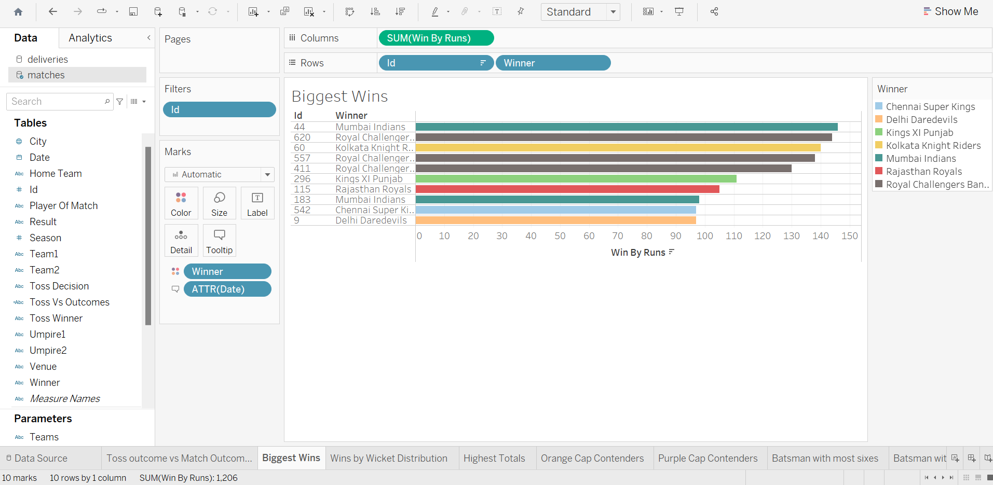
Mumbai Indians had the biggest wins of all

Slide 3
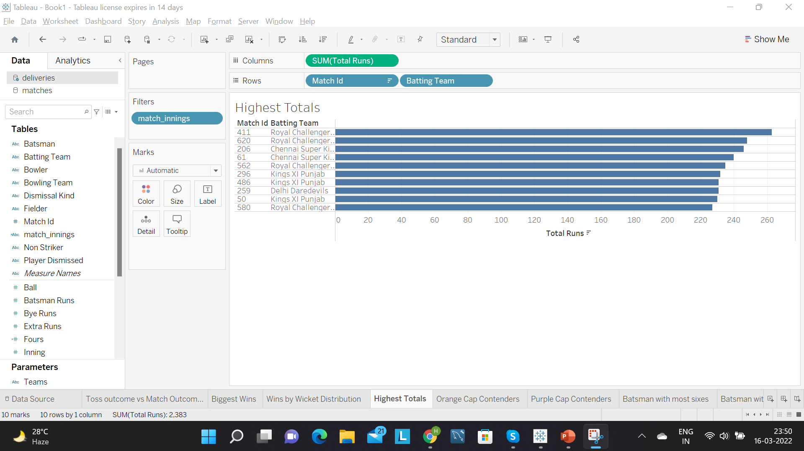
Royal Challengers Bangalore had the highest run totals

Slide 4
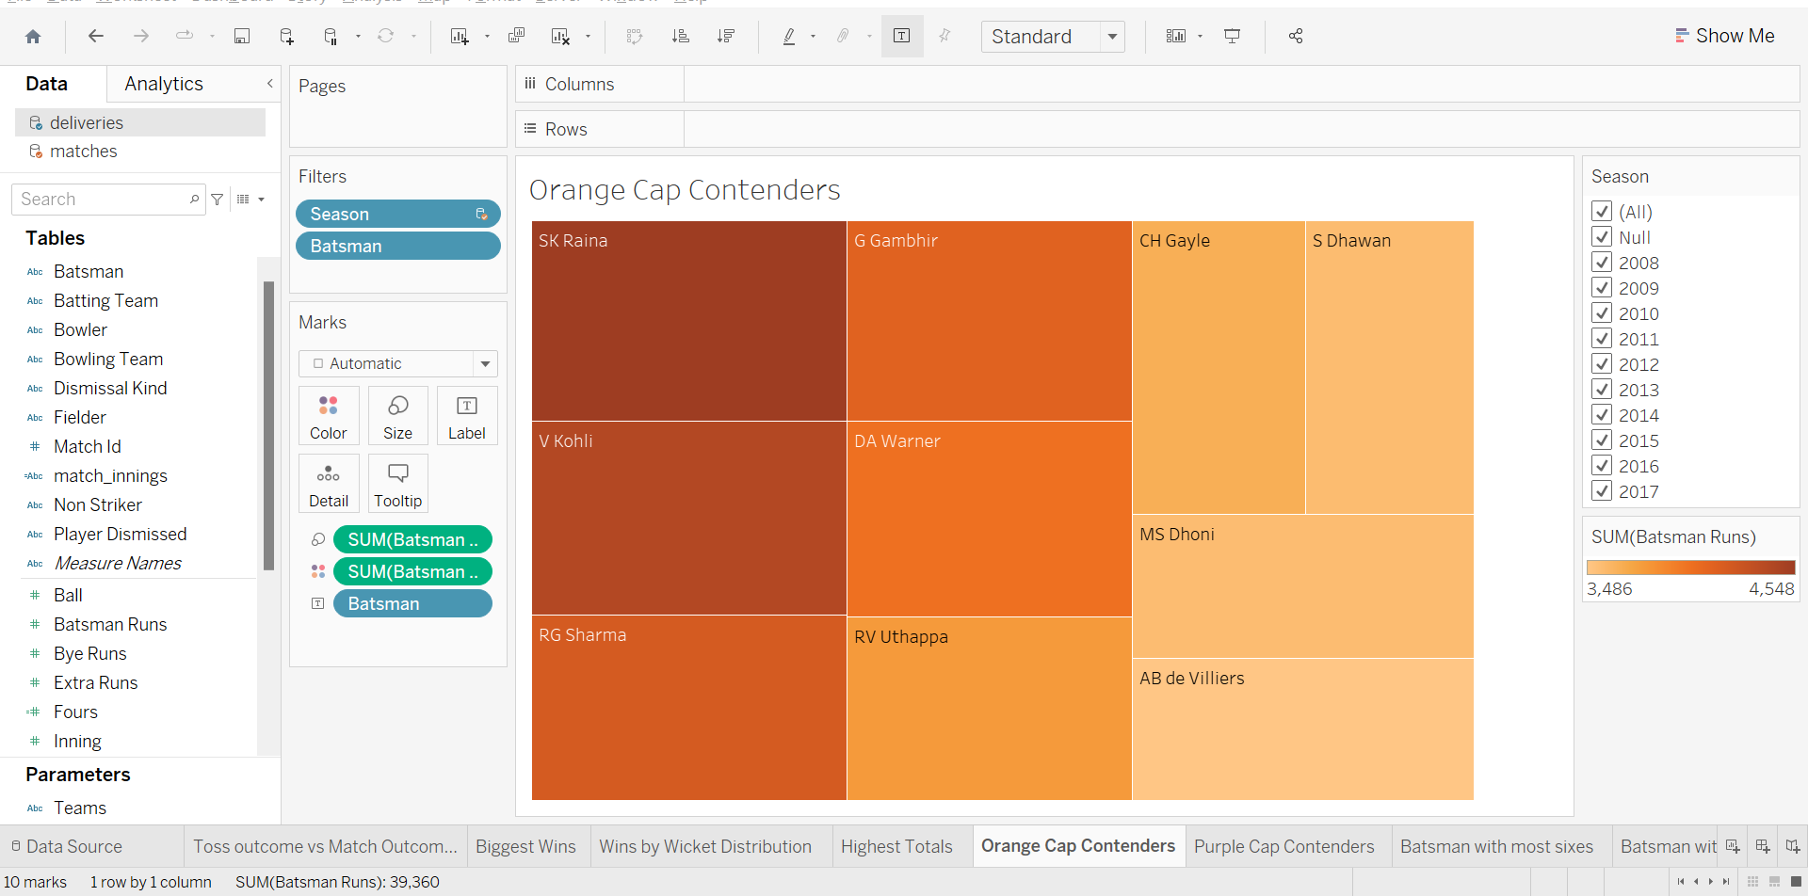
Overall SK Raina had the maximum number of runs in all seasons

Slide 5
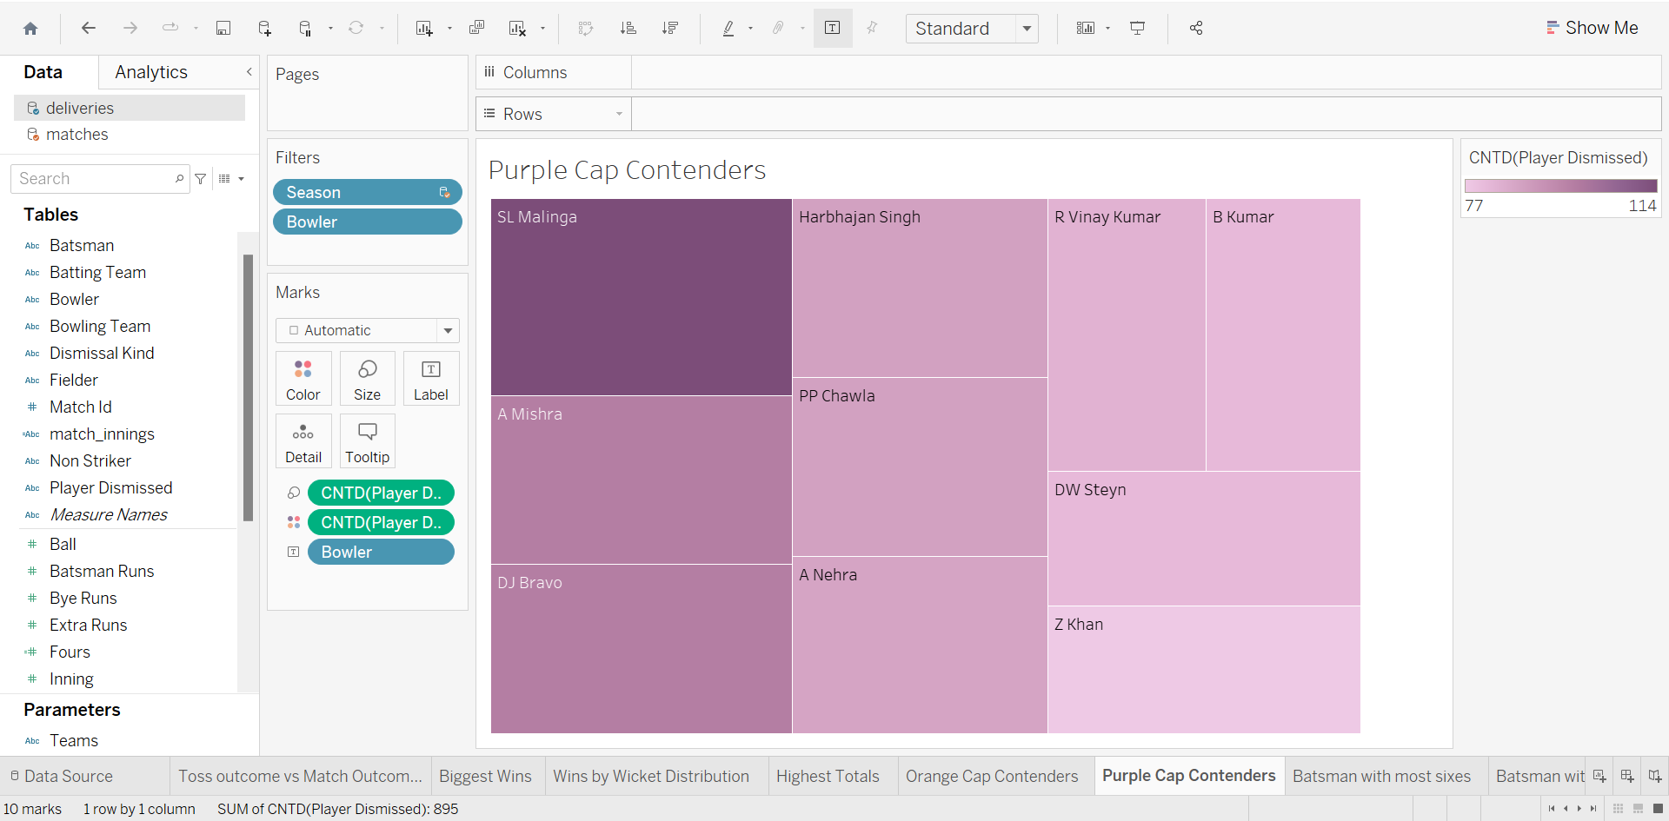
Overall SL Malinga had the maximum number of wickets

